Slide 1

World Library User Guide

Slide 2
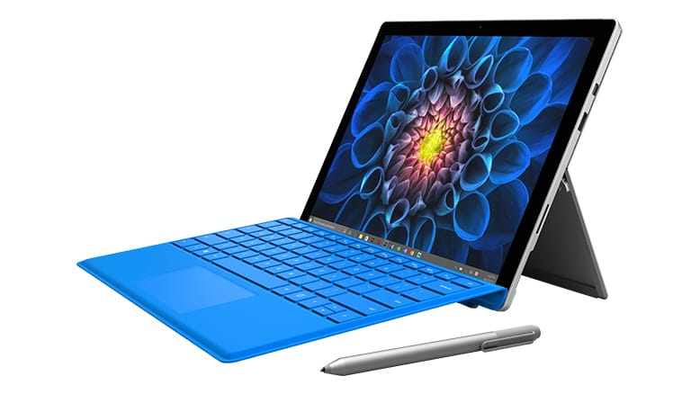

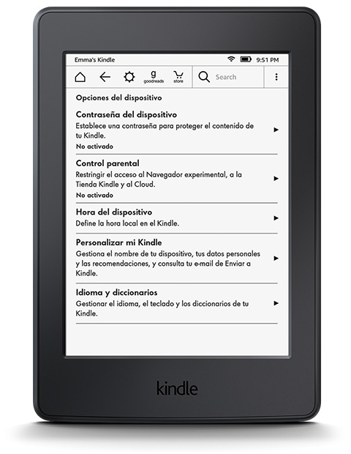
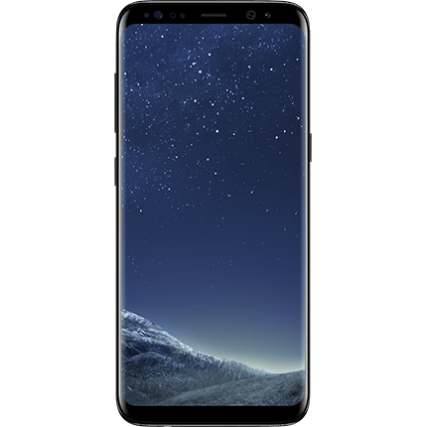
Anytime, Anywhere, Any Devices
Digitally Re-Mastered to fit any Device
Notes:
The patron is able to access content anytime, anywhere- all devices- makes reading pleasure

Slide 3
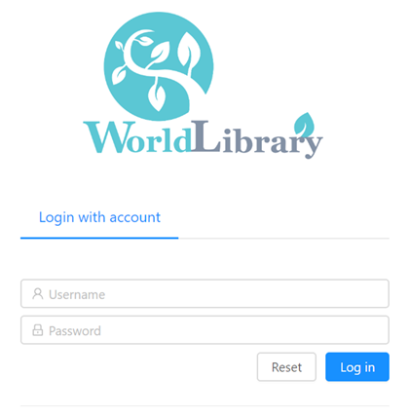
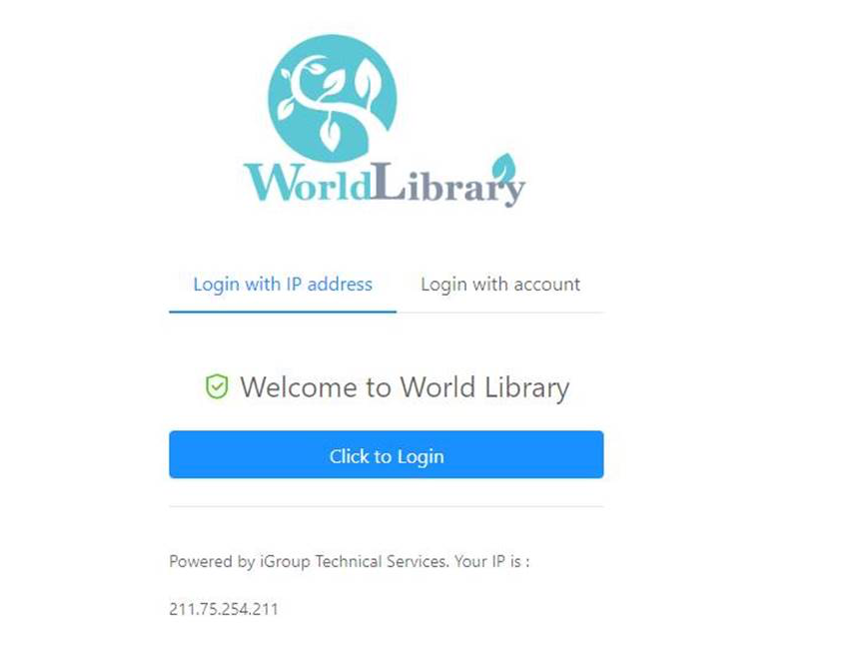
Access platform…
By username and password
By IP address

Slide 4
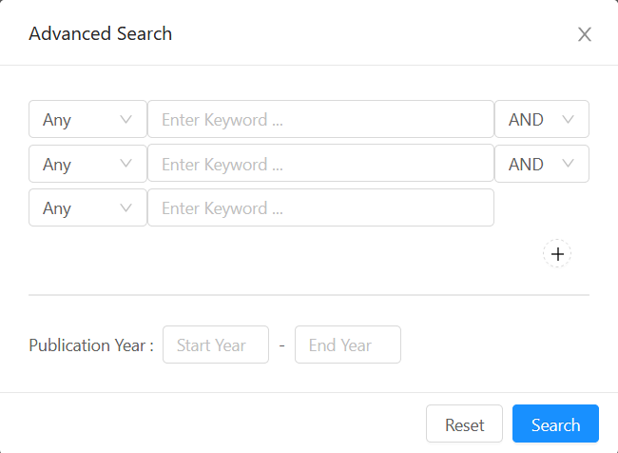
Keyword search

Slide 5
Advanced Search
Advanced search can search against
Multi fields at one time, you can
Search by these fields:
ANY|TITLE|AUTHOR|PUBLISHER|
DESCRIPTION
And
Or
Not
And
Or
Not

Slide 6
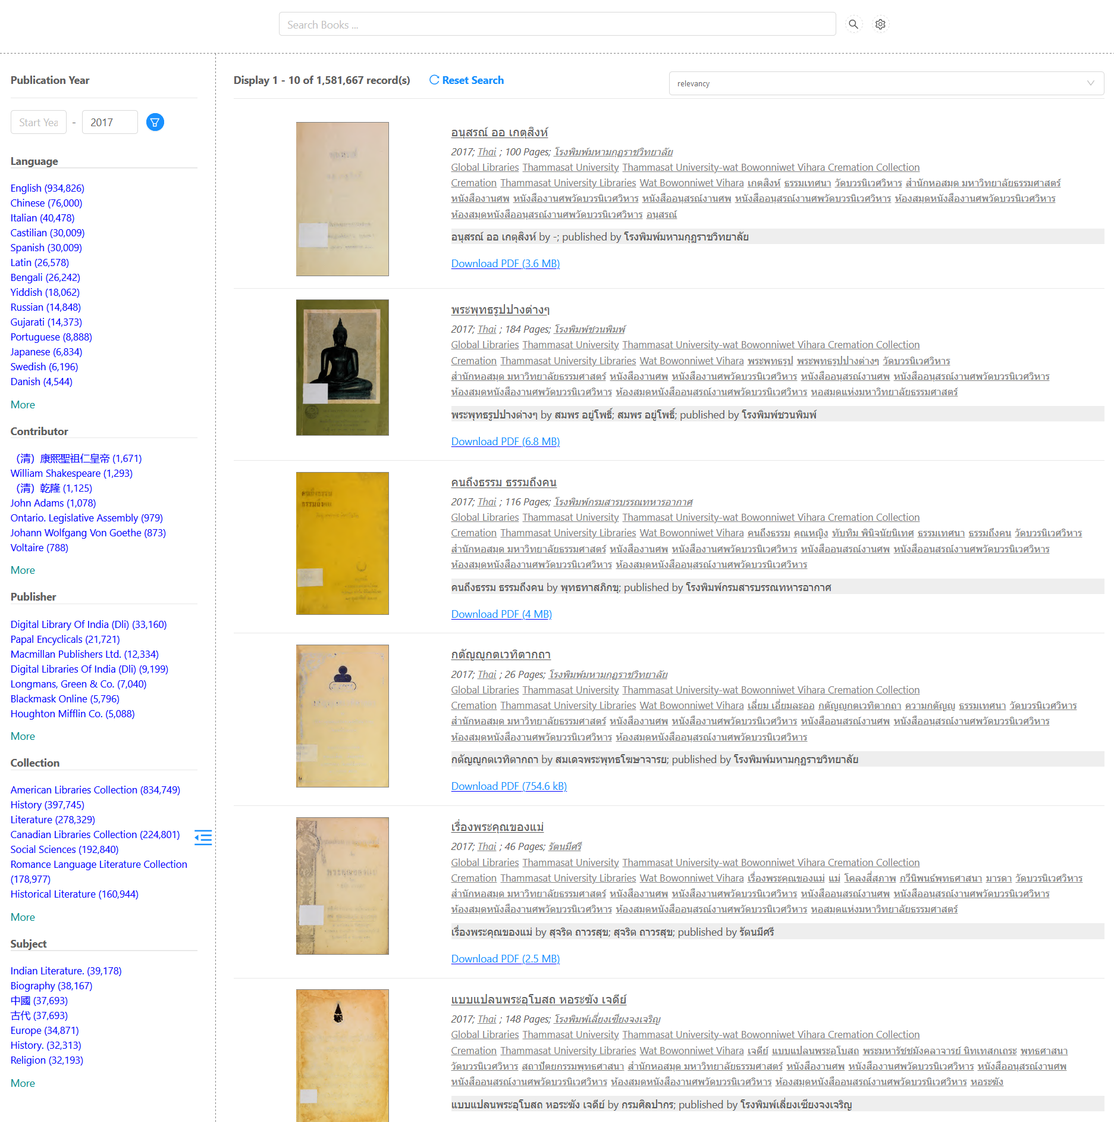
Search Icon

Slide 7
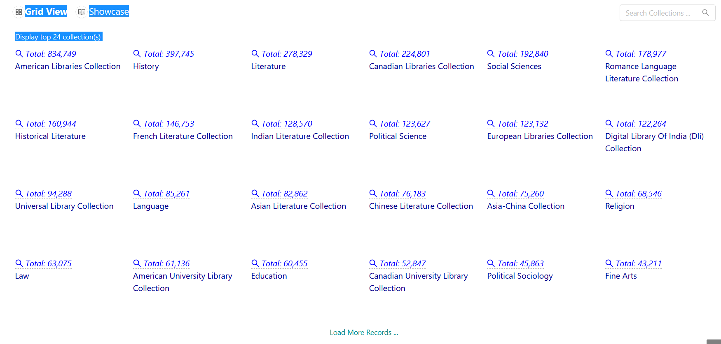

Slide 8
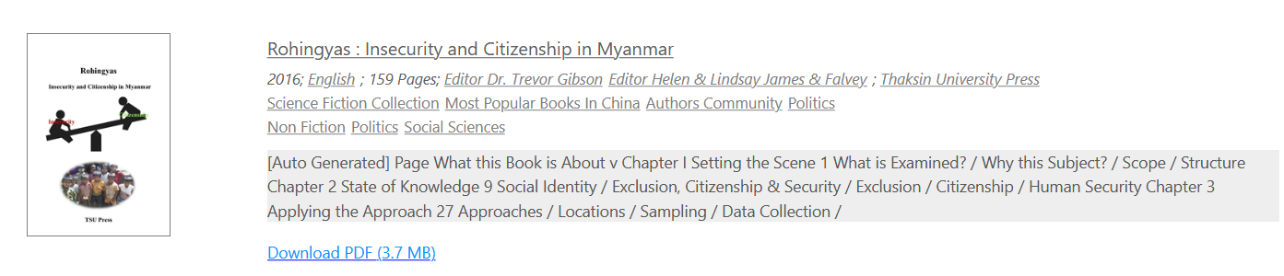
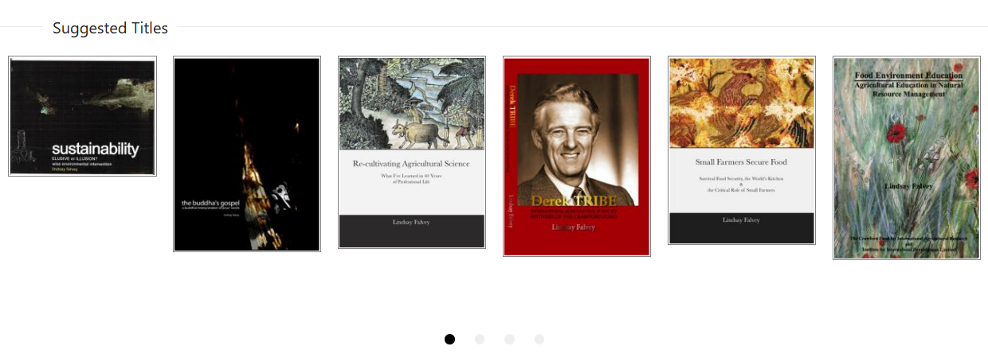
Click download to read title or save to your personal folder:

Slide 9
Download read or save E-book
Secured – Adobe Acrobat Reader DC

